Slide 1
UML + Class Diagram
Lecture

Slide 2
What is UML?
The Unified Modelling Language is a standard graphical language for modelling object oriented software
UML stands for Unified Modeling Language.
UML is different from the other common programming languages such as C++, Java, COBOL, etc.
UML is a pictorial language used to make software blueprints.
UML can be described as a general purpose visual modeling language to visualize, construct and document software system.

Slide 3
UML diagrams
Class diagrams
describe classes and their relationships
Interaction diagrams /Sequence diagram
show the behaviour of systems in terms of how objects interact with each other
Activity diagrams
show how systems behave internally
Component and deployment diagrams
show how the various components of systems are arranged logically and physically

Slide 4
01. Class Diagram

Slide 5
Class
Class is an entity which have
Data
Behavior
Example Student
Data : roll no, Name, Mobile No, GPA
Behavior: add course, drop course, withdraw course
All objects that exhibit same data and behavior can be formed into a class.
Class are usually nouns in requirement document.

Slide 6
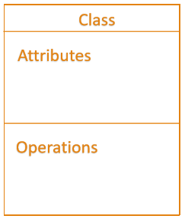
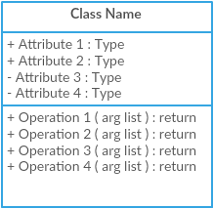
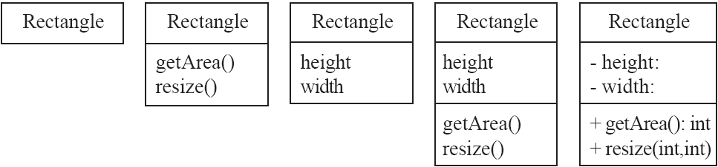
Main components of class
Class
Attributes
Operations

Slide 7
Attributes and operations
An attribute is a named property of a class that describes the object being modeled.
In the class diagram, attributes appear in the second compartment just below the name compartment.
Operations or methods are the functions of the class
Operations describe the class behavior and appear in the third compartment.

Slide 8
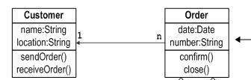
What is Class Diagram
A class diagram is a UML diagram type that describes a system by visualizing the different types of classes within a system and the kinds of static relationships that exist among them.
It illustrates
the operations and attributes of the classes.
Relationship between the classes

Slide 9
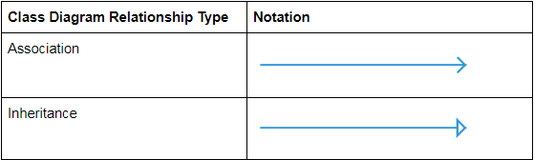
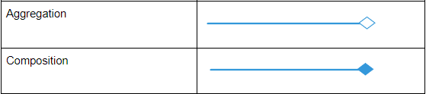
Class Diagram Relationships

Slide 10
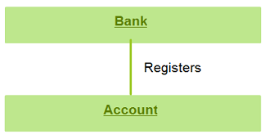
1. Associations
An association relation is established when two classes are connected to each other in any way.
For example:
A bank registers account.
An association is used to show how two classes are related to each other

Slide 11
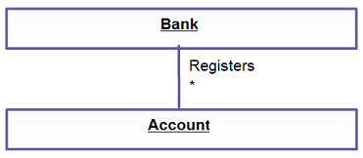
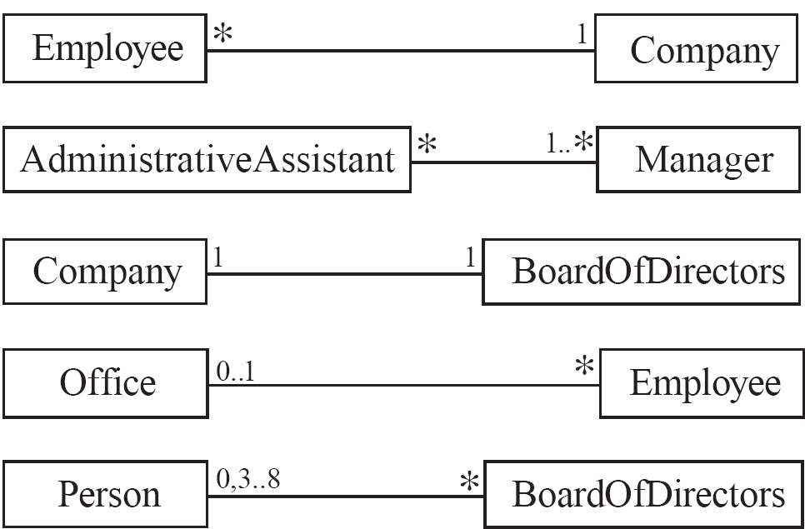
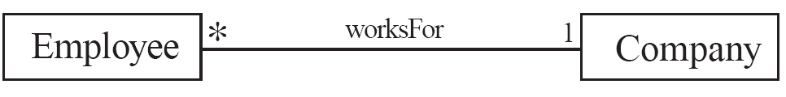
Multiplicity
An example of this kind of association is many accounts being registered by the bank. Hence, the relationship shows a star sign near the account class (one to many and many to many etc).
Symbols indicating multiplicity are shown at each end of the association
Each association can be labelled, to make explicit the nature of the association

Slide 12
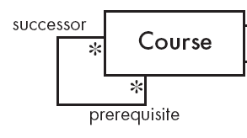
Reflexive Associations
It is possible for an association to connect a class to itself

Slide 13
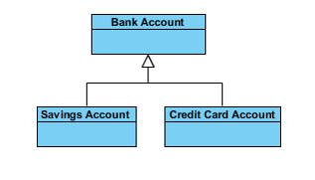
2. Generalization
Generalization is known as an “is a” relationship
the child class is a type of the parent class
Generalization is the ideal type of relationship that is used to showcase reusable elements in the class diagram.
The child classes “inherit” the common functionality defined in the parent class.

Slide 14
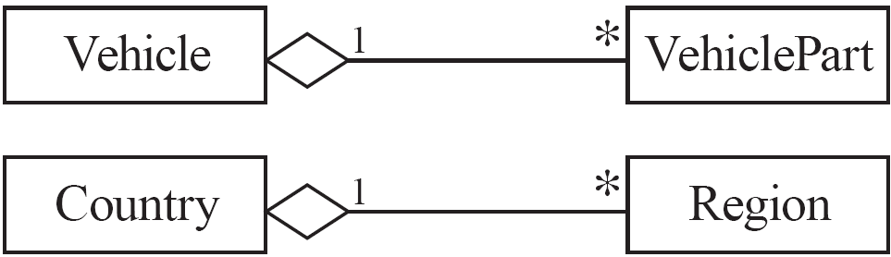

3. Aggregation
It is also called a “has a” relationship.
Aggregations are special associations that represent ‘part-of’ relationships.
While if A and B are associated with each other, such that B can exist without being associated with A, then this association in known as Aggregation.

Slide 15
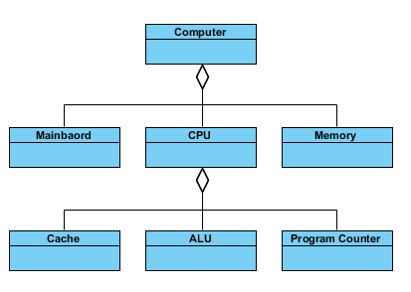

Slide 16
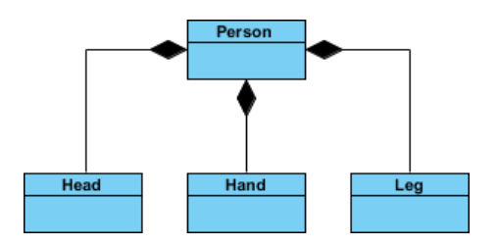

4. Composition
The composition is a variation of the aggregation relationship.
A composition is a strong kind of aggregation
if the aggregate is destroyed, then the parts are destroyed as well
If A and B two classes are related to each other such that, B ceased to exist, when A is destroyed, then the association between two objects is known as Composition. An example is Building and room.

Slide 17
How to draw class diagram
Step 1: Identify the class names
Step 2: Identify the attributes and operations of the class
Step 3: Distinguish relationships
Next step is to determine how each of the classes or objects are related to one anotherStep
Step 4: Create the Structure
First, add the class names and link them with the appropriate connectors. You can add attributes and functions/ methods/ operations later.

Slide 18
Points to Remember
The name of the class diagram should be meaningful to describe the aspect of the system.
Each element and their relationships should be identified in advance.
Responsibility (attributes and methods) of each class should be clearly identified
Use notes whenever required to describe some aspect of the diagram.
At the end of the drawing it should be understandable to the developer/coder.
Finally, before making the final version, the diagram should be drawn on plain paper and reworked as many times as possible to make it correct.
Notes:
https://www.visual-paradigm.com/guide/uml-unified-modeling-language/what-is-class-diagram/

Slide 19
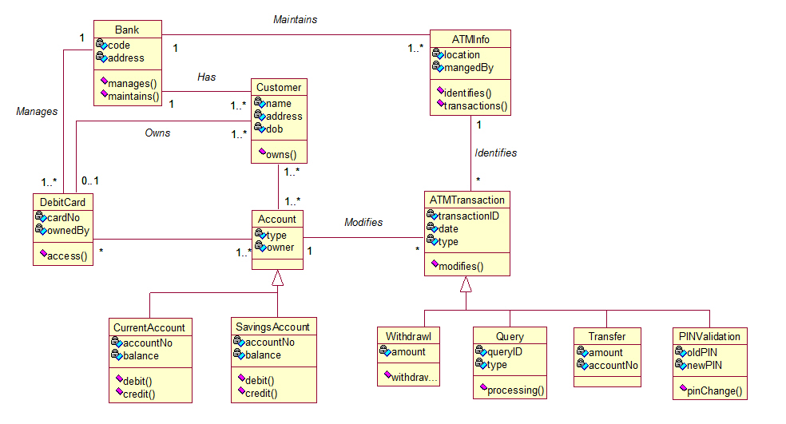

Slide 20
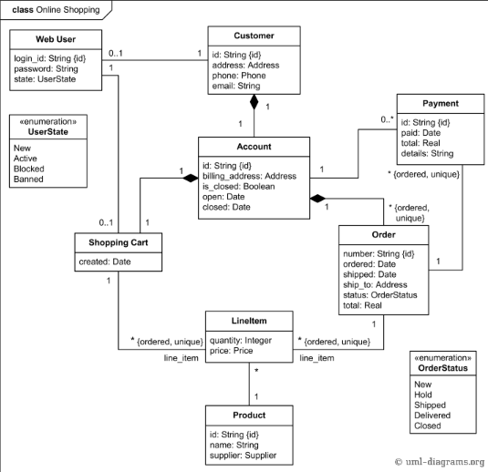

Slide 21
Component Diagram
Lecture

Slide 22
Component diagram
Component diagrams are used to visualize the organization of system components and the dependency relationships between them.
They provide a high-level view of the components within a system.
The components can be a software component such as a database or user interface; or a hardware component such as a circuit, microchip or device; or a business unit such as supplier, payroll or shipping.

Slide 23
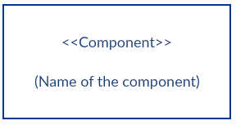
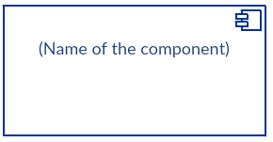
Symbol of Component
There are two commonly used symbols for component:
Rectangle with the component stereotype (the text <<component>>). The component stereotype is usually used above the component name to avoid confusing the shape with a class icon. (Fig1)
Rectangle with the component icon in the top right corner and the name of the component. (Fig 2)
Fig 1
Fig 2

Slide 24
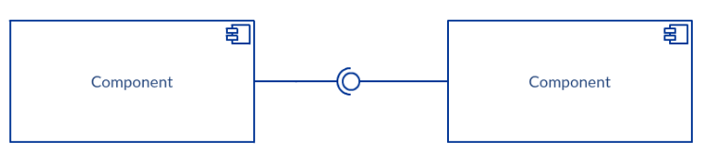
Provided and Required Interface
Interfaces in component diagrams show how components are wired together and interact with each other.
Required interface is represented with a semi-circle and a solid line.
Provided interface is represented with a circle and solid line.
This shows that one component is providing the service that the other is requiring.

Slide 25
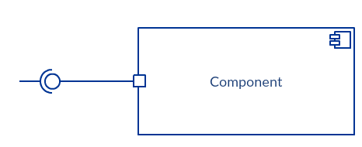
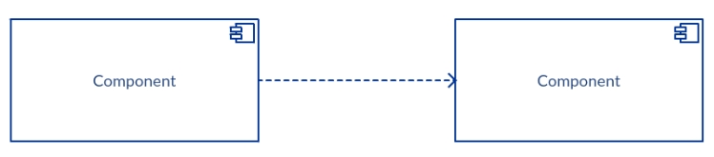
PoRT
Dependencies
Port is represented by the small square at the end of a required interface or provided interface
It is used when the component delegates the interfaces to an internal class
you can just as well use a dependency arrow to show the relationship between two components. If you don’t want to use ball and socket join

Slide 26
How to draw
Step 1: figure out the purpose of the diagram and identify the artifacts such as the files, documents etc. in your system or application that you need to represent in your diagram.
Step 2: As you figure out the relationships between the elements you identified earlier, create a mental layout of your component diagram
Step 3: As you draw the diagram, add components first, grouping them within other components as you see fit
Step 4: Next step is to add other elements such as interfaces, classes, objects, dependencies etc. to your component diagram and complete it.
Step 5: You can attach notes on different parts of your component diagram to clarify certain details to others

Slide 27
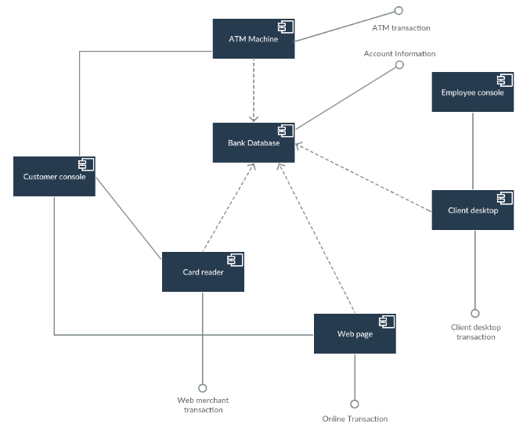
Component Diagram of
ATM system
Notes:
Sequence Diagram of online exam system

Slide 28
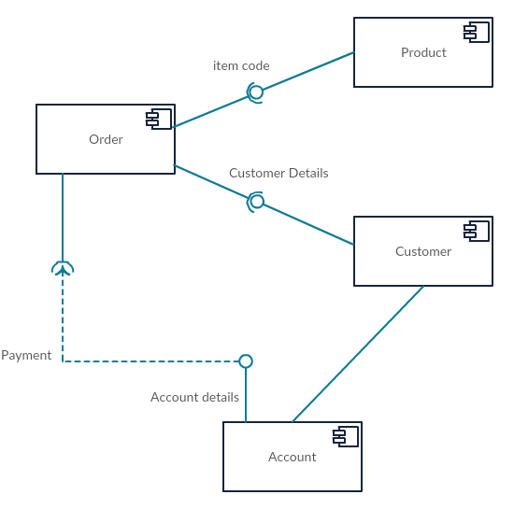
Component Diagram of
Online Shopping
Notes:
Sequence Diagram of online exam system

Slide 29
Deployment Diagram

Slide 30
Deployment Diagram
A deployment diagram is a UML diagram type that shows the execution architecture of a system, including nodes such as hardware or software execution environments, and the middleware connecting them.
Deployment diagrams are typically used to visualize the physical hardware and software of a system.
Using it you can understand how the system will be physically deployed on the hardware.

Slide 31
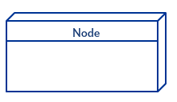
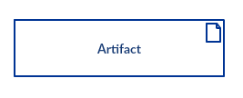
Components of Deployment Diagram
Node:
A node, is a physical entity that executes one or more components, subsystems or executables.
A node could be a hardware or software element.
Artifacts:
Artifacts are concrete elements that are caused by a development process.
Examples of artifacts are libraries, archives, configuration files, executable files etc.

Slide 32
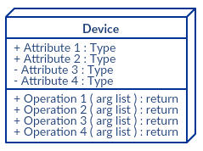
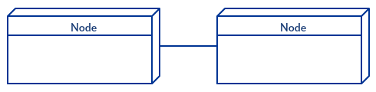
Components of Deployment Diagram
Device:
A device is a node that is used to represent a physical computational resource in a system. An example of a device is an application server.
Communication Association
This is represented by a solid line between two nodes. It shows the path of communication between nodes.

Slide 33
How to draw Deployment Diagram
Step 1: Identify the nodes and devices within the system you’ll be visualizing with the diagram.
Step 2: Figure out the relationships between the nodes and devices. Once you know how they are connected, proceed to add the communication associations to the diagram.
Step 3: Identify what other elements like components, active objects you need to add to complete the diagram.
Step 4: Add dependencies between components and objects as required.

Slide 34
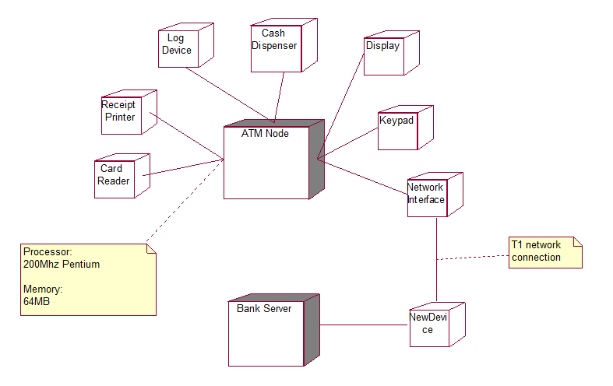
Deployment Diagram of
ATM
Notes:
Sequence Diagram of online exam system

